Slide 1

“Everybody should learn how to program a computer…
…because it teaches you how to think”
- Steve Jobs

Slide 2
What is Programming?
or as we call it..
CODING

Slide 3
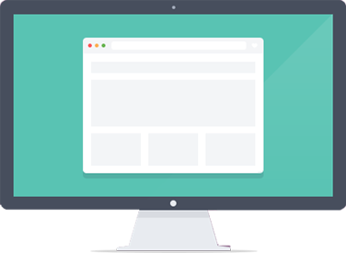
CODE =
Precise set of instructions (or rules) a computer can understand and execute

Slide 4


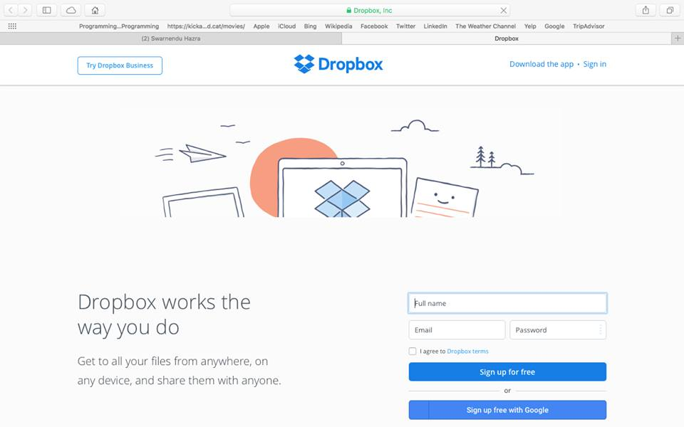


Create cool websites…

Slide 5


…games…

Slide 6
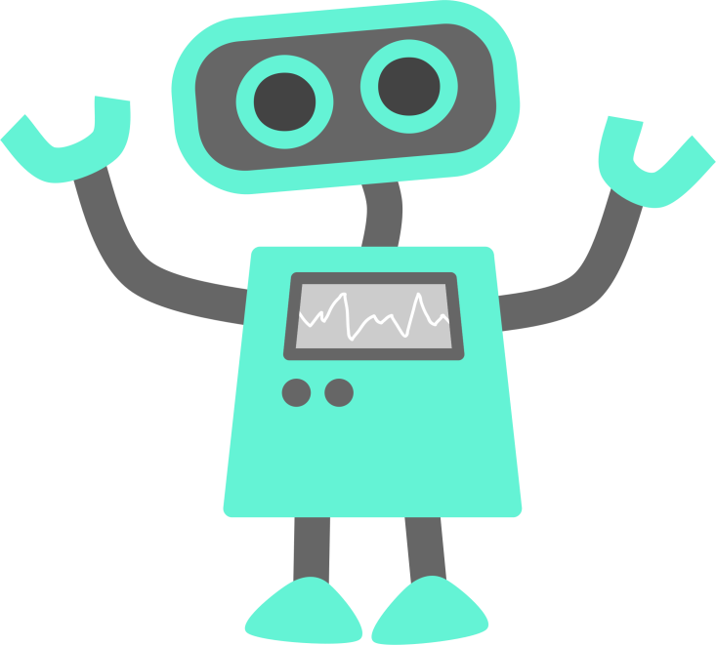
…power robots…
…and that’s not all!
In fact, you can do almost anything using programming! Be it developing android apps, or a Linux script to make a dictionary for yourself, or even follow the lyrics of a song you just heard, the possibilities are just endless!

Slide 7




Programming Languages
Languages through which we “tell” the computer what we want it to do
C, C++, Java, Python, Perl
HTML, CSS, JavaScript, PHP

Slide 8
Lets start today!
Some projects you can check out!
How a school is teaching its students how to code using video games
https://www.youtube.com/watch?v=OxYW0bqtiTo
Web-based accounting solution created by cs50 students
http://www.geocities.ws/nooriik/index.html
Personal website search engine created by cs50 student
http://leafii.com/

Slide 9
Demos Begin

Slide 10
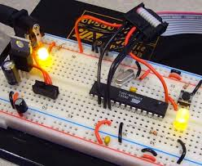
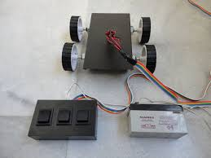
Manual Robotics

Slide 11
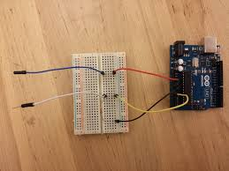
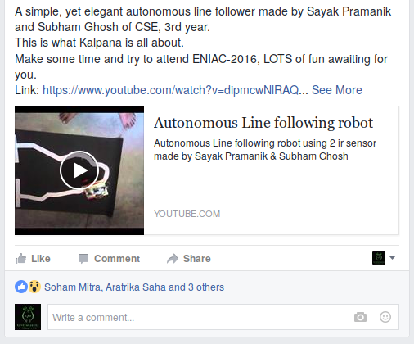
Autonomous Robotics

Slide 12
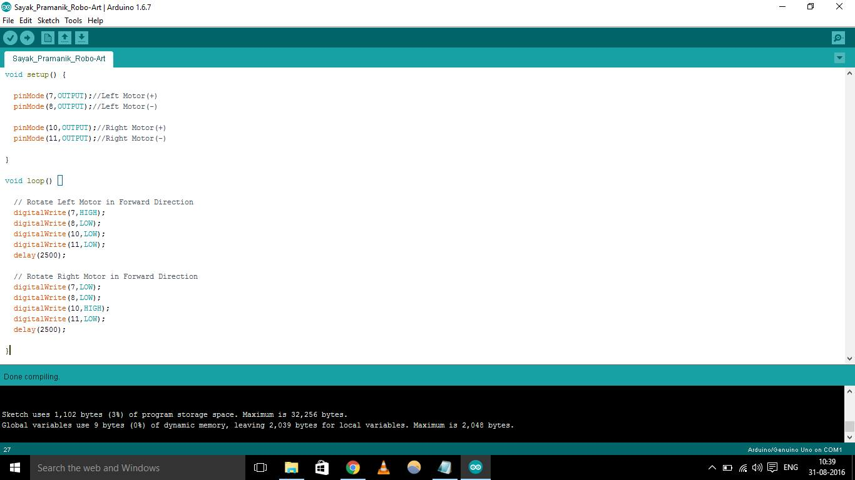

Slide 13
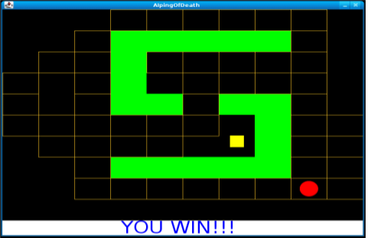
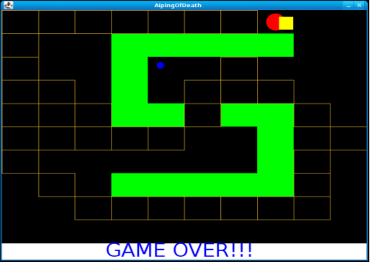
CS50, C and AI

Slide 14
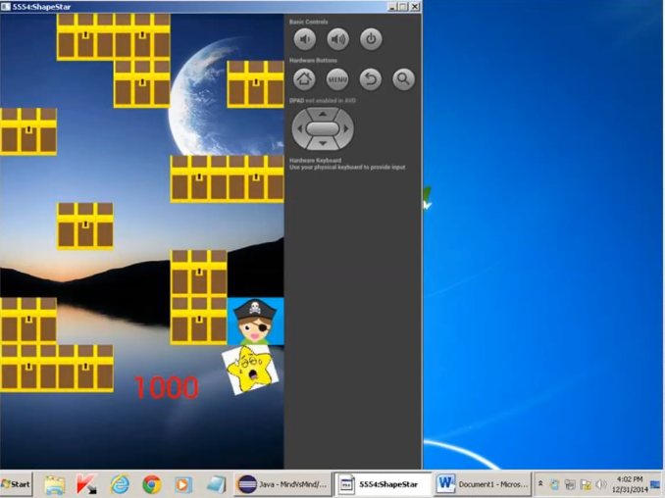

Slide 15

Data Analytics and R
Finding knowledge and useful patterns from huge amounts of data (that we generate).

Slide 16
Let's talk about Python

